Slide 1
The The Swedish Experience with tobacco is unique and stems from the high prevalence
of snus use among tobacco users in Sweden. While total tobacco consumption levels in
Sweden are comparable with other countries in Europe, the use of Swedish snus has increased
at the expense of smoking. The consequence being that the Swedes are at the lowest risk of dying
from any tobacco-related disease compared to any other western country. Including oral cancer.
This unique tobacco consumption pattern is now being replicated in Norway.
“It is the smoke from combustible tobacco products—not nicotine—that injures and kills millions of smokers.”
American Cancer Society (2018)
“It's not the nicotine that kills you, it's all the other carcinogens in lighting tobacco on fire.”
FDA Commissioner Scott Gottlieb
“Long-term use of nicotine by ‘snus’ users has not been found to increase the risk of serious health problems in adults.”
Public Health England (2018)
“The general medical position is that nicotine itself poses few health risks, except among certain vulnerable groups.”
Cancer Research UK

Slide 2
OVERALL TOBACCO USE eu28 – men & women
Daily tobacco users - cigarettes, oral, chewing or nasal tobacco (%)
Source: Eurobarometer 458, May 2017

Slide 3
Daily smokers eu28 – men & women
Prevalence of daily smokers in the EU (%)
Source: Eurobarometer 458, May 2017, Statistisk Sentralbyrå 2016 (Norge)

Slide 4
Ex-smokers eu28 – men & women
Prevalence of Ex-smokers in the EU (%)
Source: Eurobarometer 458, May 2017

Slide 5
Snus and snuff USE eu28 – men & women
Used or tried oral tobacco (snus), chewing or nasal tobacco (snuff) (%)
Source: Eurobarometer 458, May 2017

Slide 6
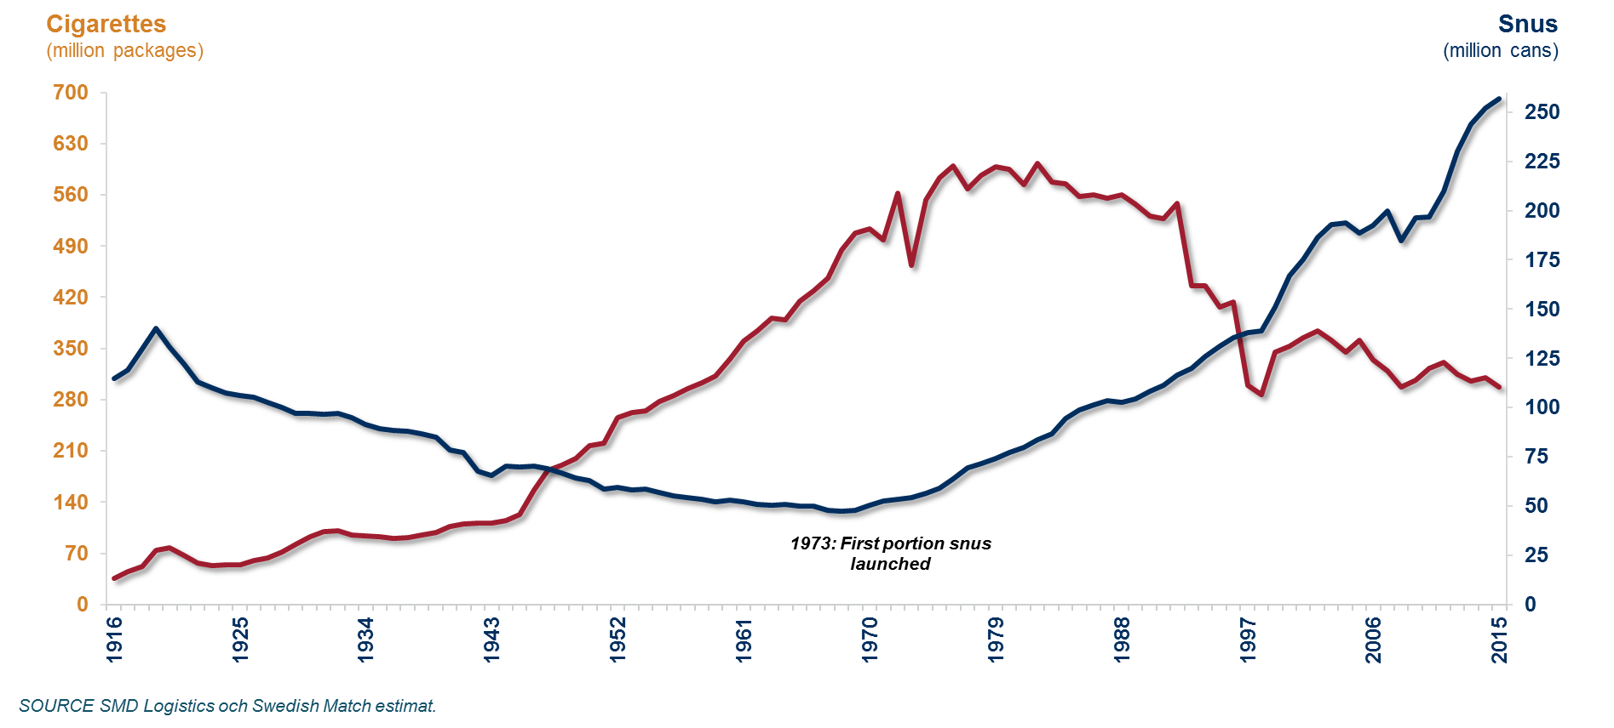
Snus & Cigarette consumption, Sweden

Slide 7
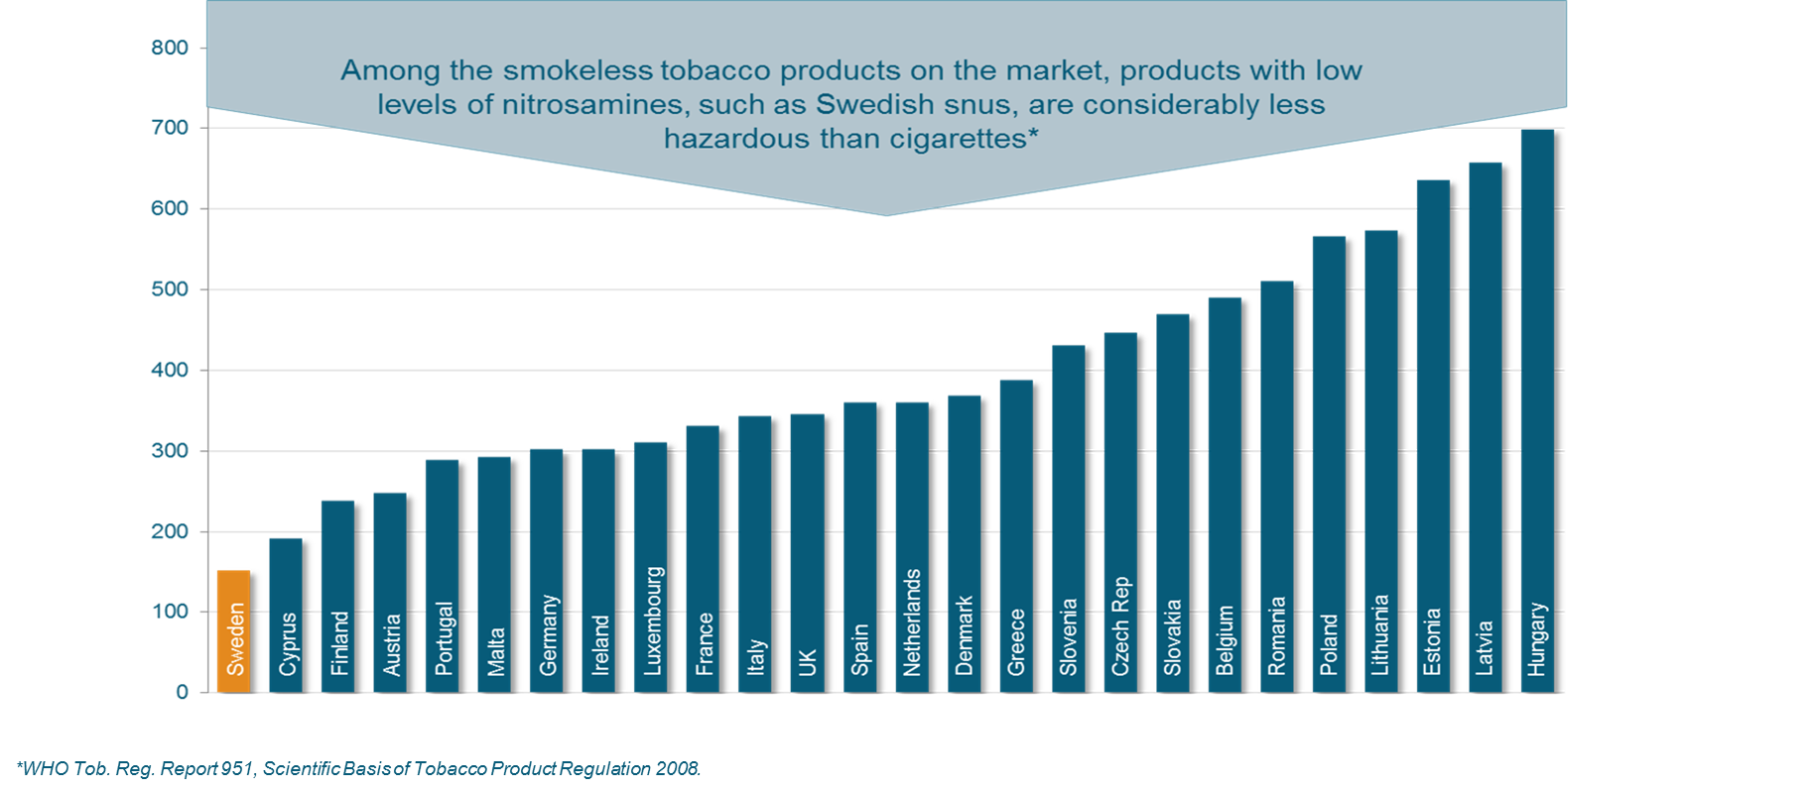
Mortality attributable to tobacco, men per 100,000 (WHO 2012) – A comparison between the EU countries

Slide 8
Source: WHO 2012, Mortality Attributable to tobacco

Slide 9
Source: WHO 2012, Mortality Attributable to tobacco

Slide 10
Källa: WHO/IARC, 2008

Slide 11
